Slide 1
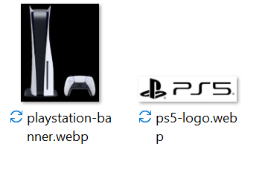
Additional Challenge
For this challenge, follow the instructions in the slide.
You are given these 2 images on the right.
For this exercise, you can leave the images together with the html file.
Create the html file with the name newsletter.html

Slide 2
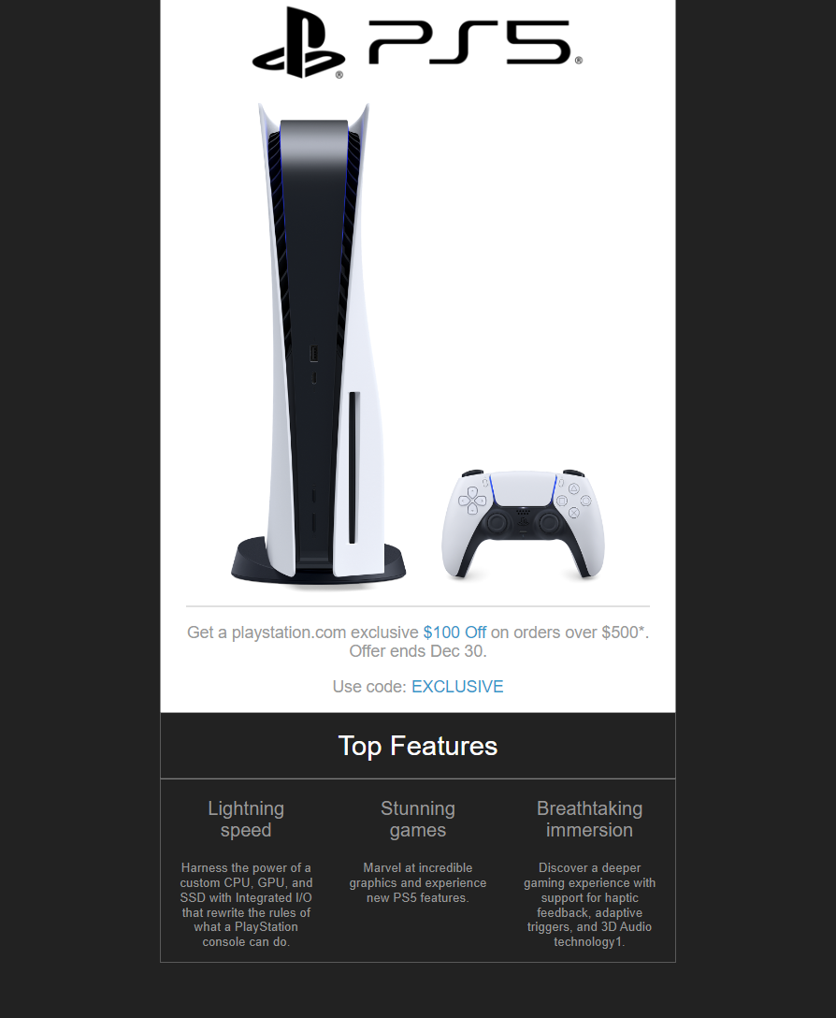
Let’s try to create this newsletter layout
Think of each element like a piece of a puzzle that you need to put together, each contributing to the overall layout of the page
We start off with the main container that contains everything else.
<div id="container"> ...
</div>

Slide 3
Then gradually add each element starting from the top and working downwards.
The <div> tag is used whenever we want to create a group of content
<div id=“product"> <div id="exclusive"> <div id=“top-features">

Slide 4
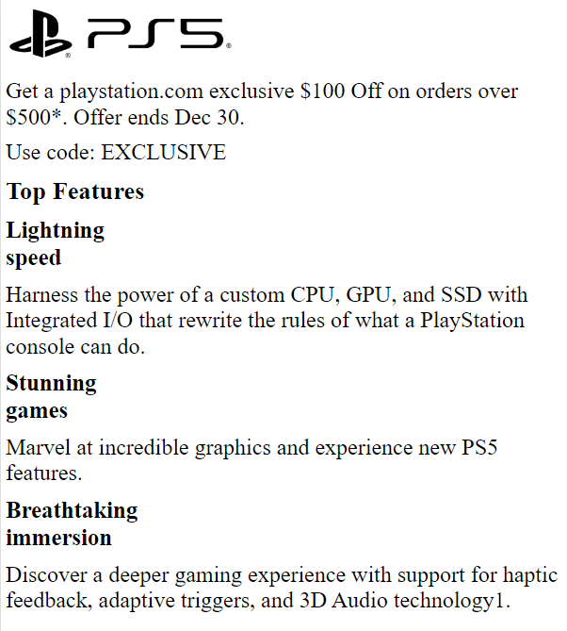
Create a boilerplate.
Next, use the base code below for your html’s <body>
Pay attention to how the content nested within the <div> used to group the content.
You should an output that looks like one on the left.
<body>
<div id="container">
<img src="ps5-logo.webp"/>
<div id="hero"></div>
<div id="exclusive">
<div>
<p>Get a playstation.com exclusive <span class="blue">$100 Off</span> on orders over $500*. Offer ends Dec 30.</p>
<p>Use code: <span class="blue">EXCLUSIVE</span> </p>
</div>
</div>
<h2>Top Features</h1>
<div id="top-features">
<div class="feature"> <h3>Lightning <br> speed</h3><p class="special">Harness the power of a custom CPU, GPU, and SSD with Integrated I/O that rewrite the rules of what a PlayStation console can do.</p></div>
<div class="feature"> <h3>Stunning <br> games</h3><p class="special">Marvel at incredible graphics and experience new PS5 features.</p> </div>
<div class="feature"> <h3>Breathtaking <br> immersion</h3><p class="special">Discover a deeper gaming experience with support for haptic feedback, adaptive triggers, and 3D Audio technology.</p> </div>
</div>
</div>
</body>

Slide 5
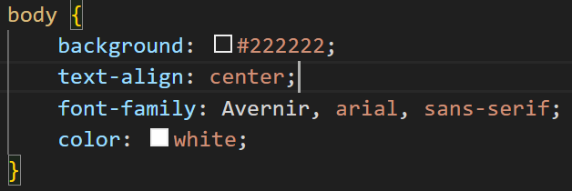
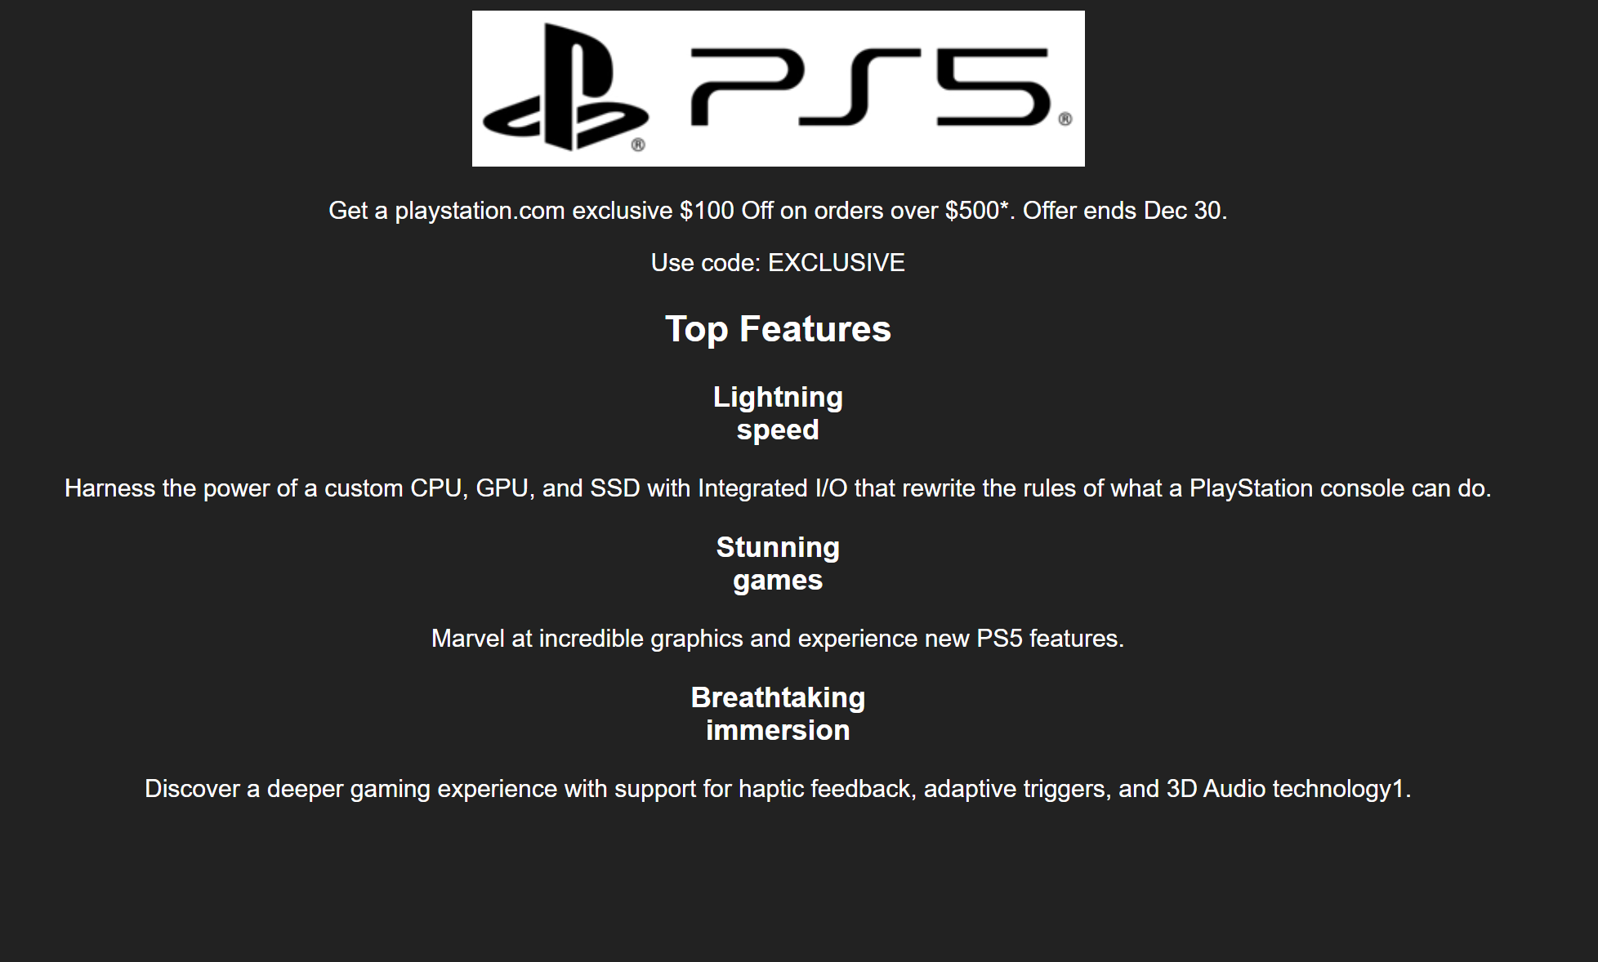
Add a style for body in the <style> tag
Save and preview the file which should appear similar to the screenshot below
Note: Either use the <style> tag or you can use an external css.

Slide 6
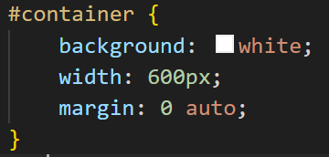
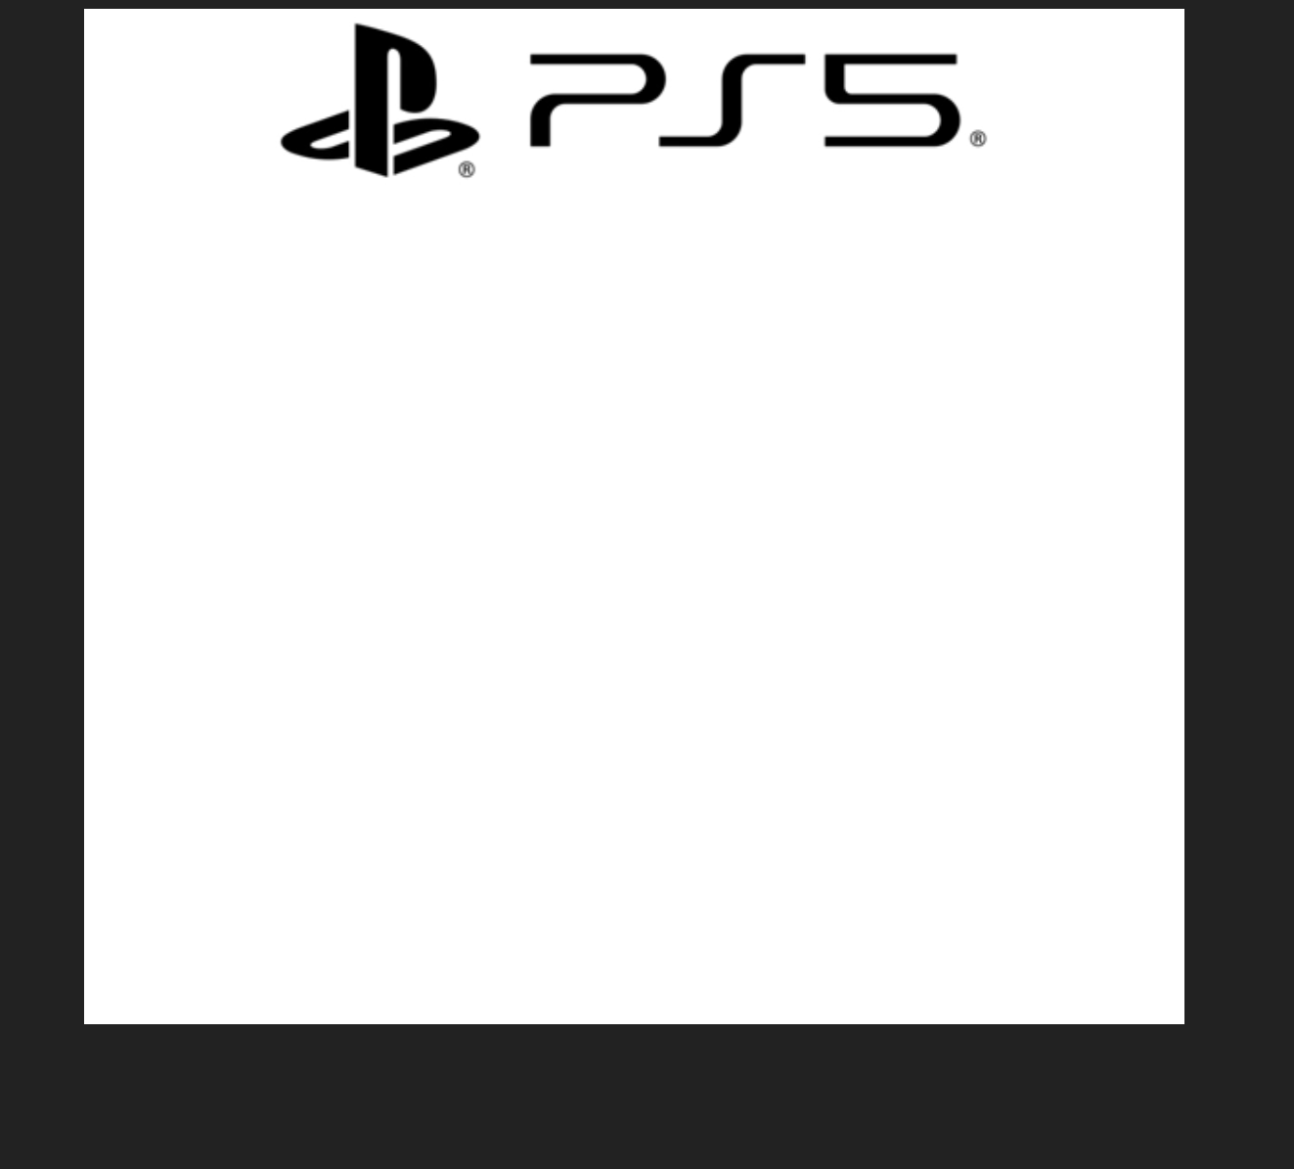
Continue to add the style for #container
The margin settings here will set the top and bottom to 0px, while the left and right will be set to auto. This will centralise the div on the page.
Save and preview the file

Slide 7
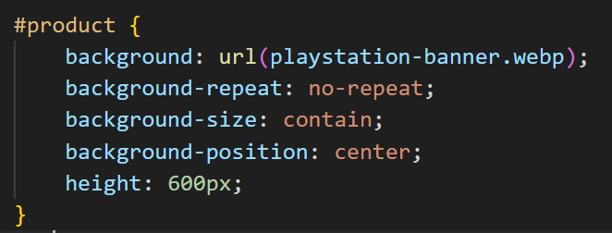
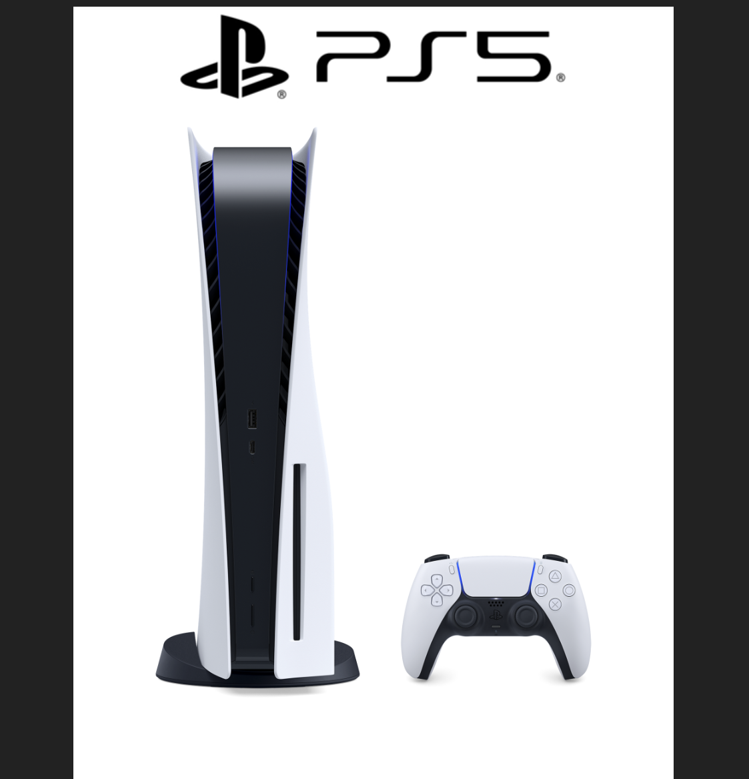
Add the following styles for #product. We add a height property so that the background image can be seen.
Save and preview

Slide 8
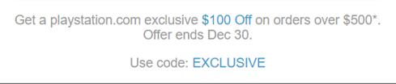
The next section is the div with exclusive promotion on the webpage with some text.
<div id="exclusive"> ...
</div>

Slide 9
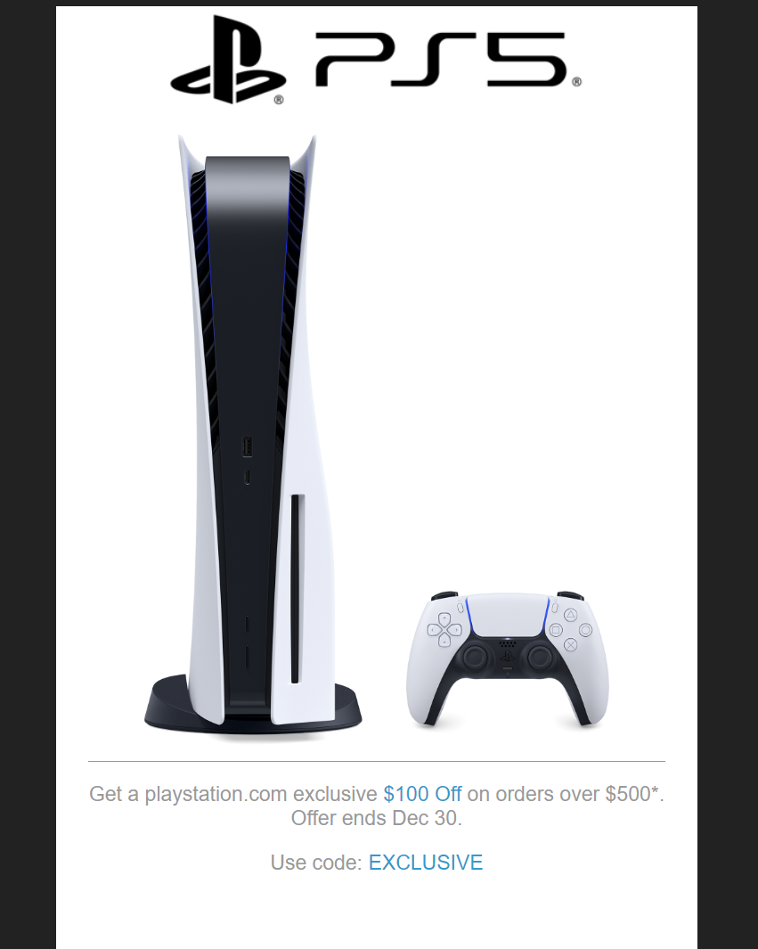
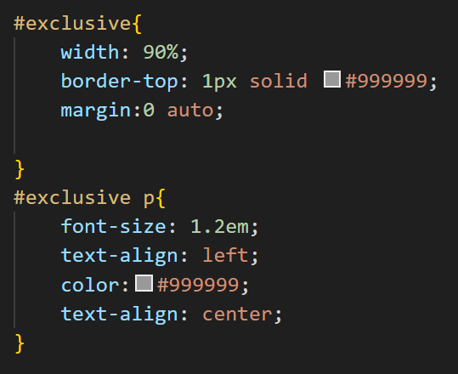
Add the following styles for #exclusive
Save and preview
Add in the blue class shown in next slide to get the blue text.

Slide 10
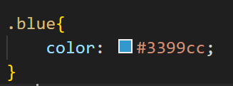
Because we have the <span> that has the class of ‘blue’ the text in the paragraph can show up as blue.
Save and preview. You should see the blue text now.

Slide 11
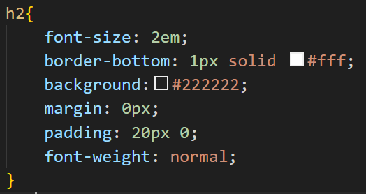
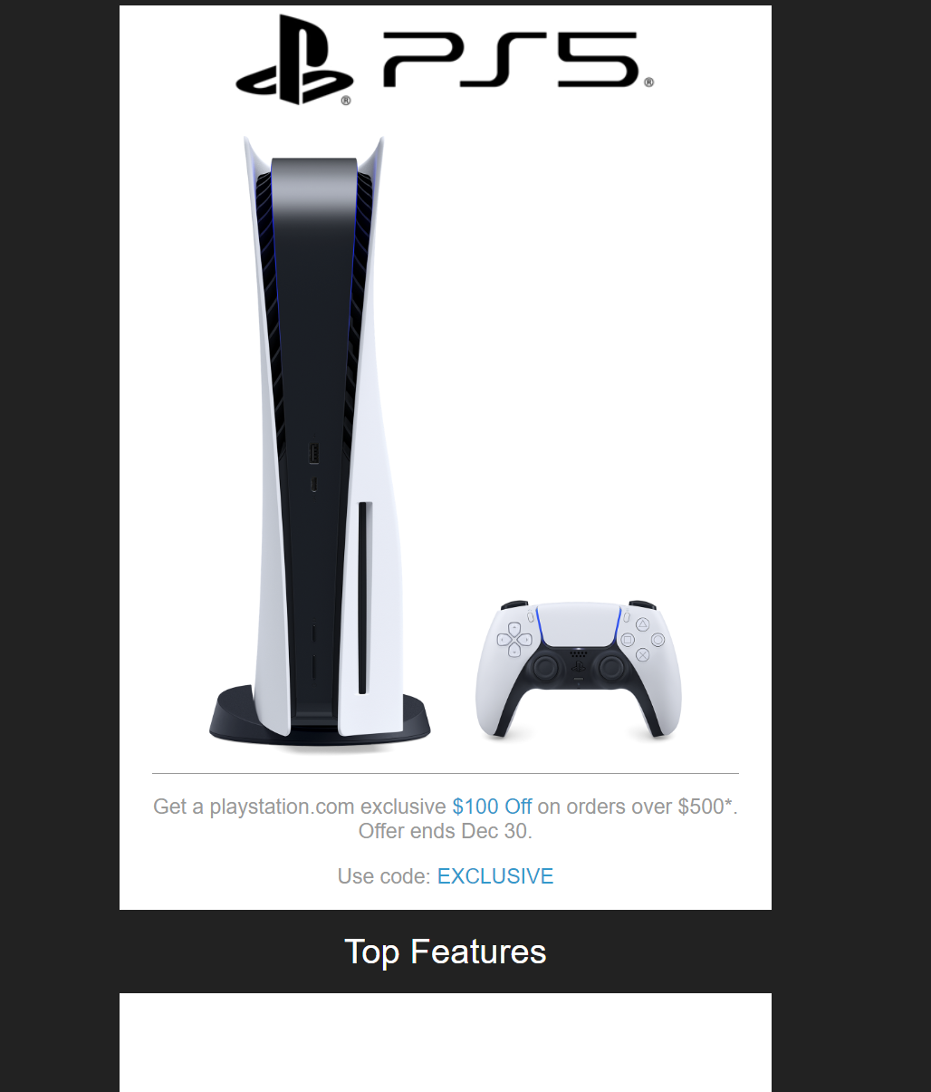
Next, add the style for h2
Save and preview

Slide 12
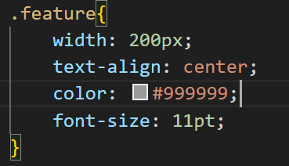
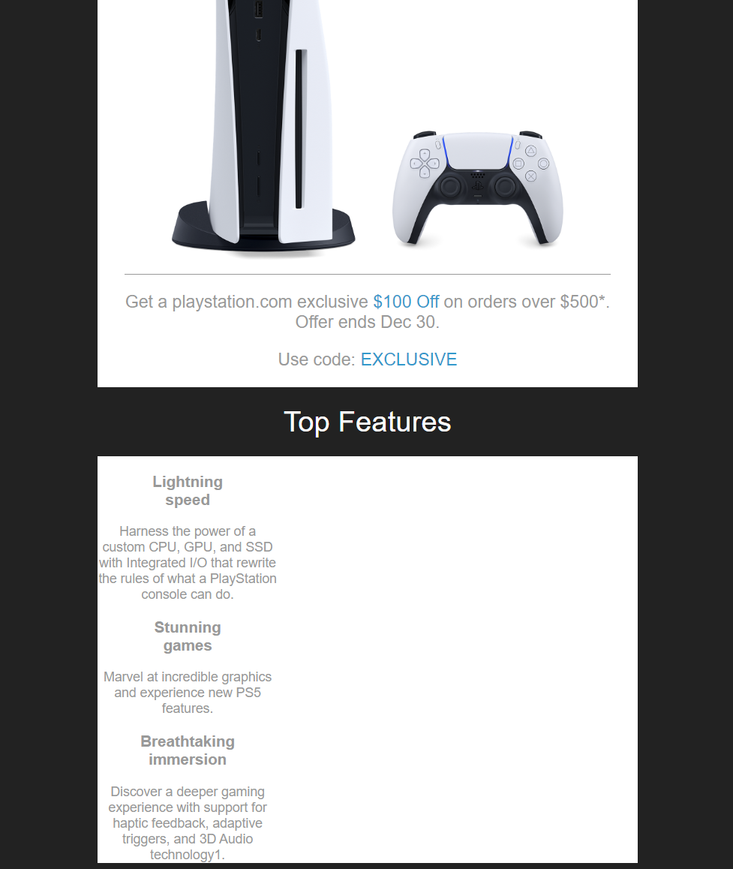
Add the style for .feature
Save and preview
You should see the text for the features coming down in a row but that is not what we want.
We want them to appear side by side.
We will use flexboxes to change that in the next slide.

Slide 13
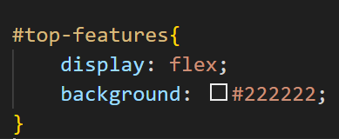
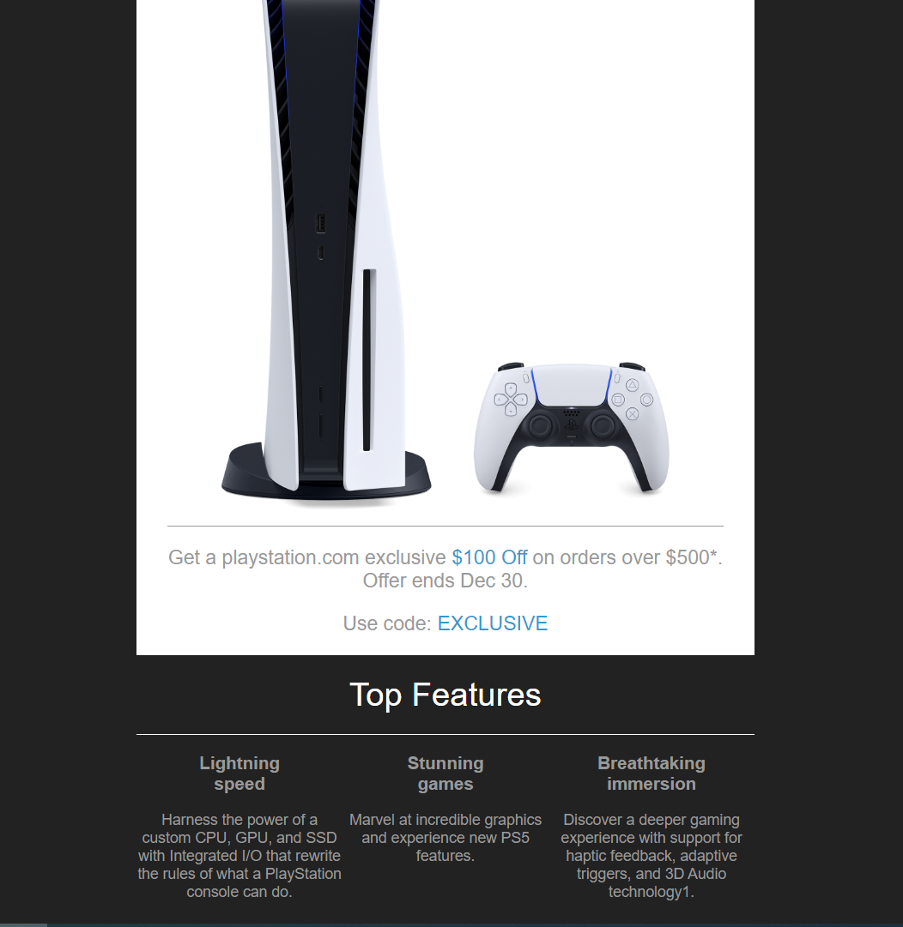
Add the style for .top-features.
Using flex we changed the container to display the items side by side and added back a black background for the container.
Save and preview.

Slide 14
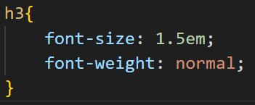
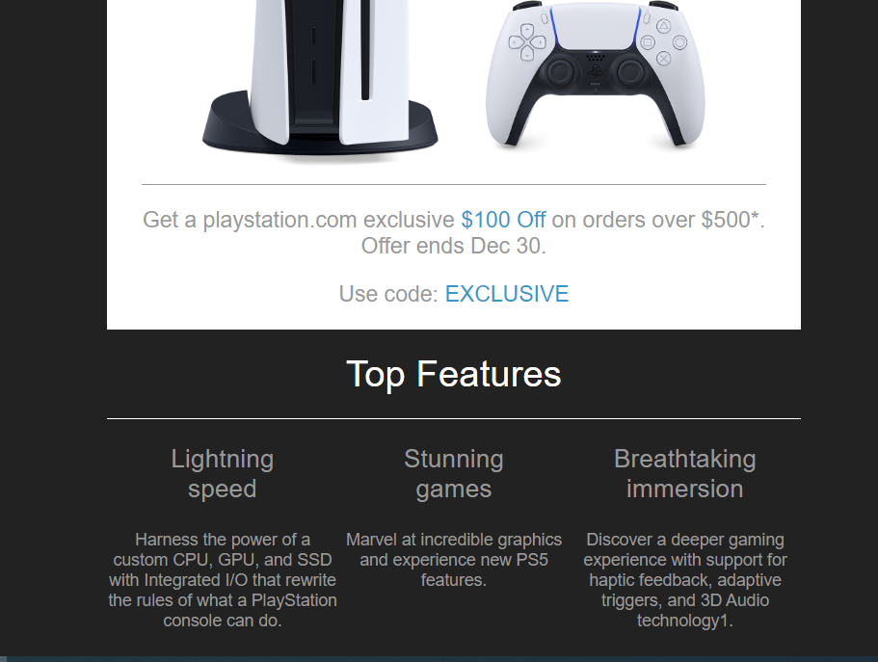
Add the style for .h3
This is done to increase the font size and the boldness of the font
Save and preview.

Slide 15
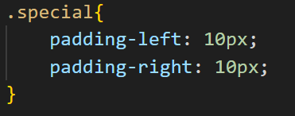
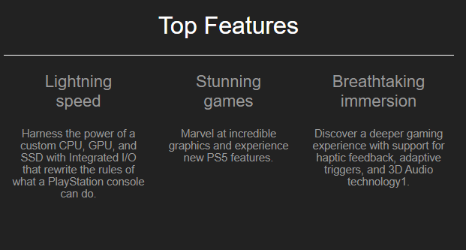
Add the style for .special
This is done to add some padding to make the text more readable because the words are too close together earlier.
Save and preview.

Slide 16
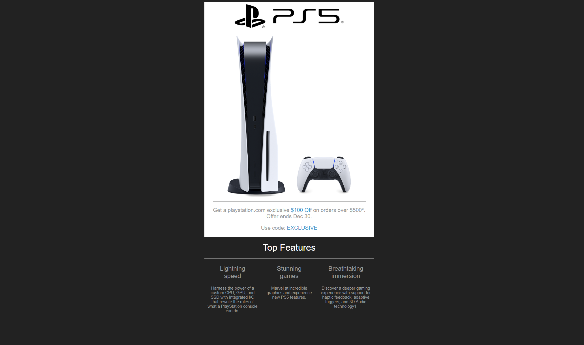
Congratulations! You have finished the layout for the online newsletter.

